Slide 1

The anatomy of a modern breakup
A Multi-Dataset Sentiment & Engagement Analytics Pipeline
Faculty of Data Science - DS26 Data Analytics
Presented by : O’kah Ahone Ebwekoh | Muhammad Sharjeel | Tharun Kumar
Matricules : 80770239 | 99871705 | 74937166
Supervisor : Prof. Dr. Nor Aziza Hitam
Year : 2025-2026

Slide 2
Summary
1.
Project overview
2.
Checkpoint 1
5.
Checkpoint 4
3.
Checkpoint 2
6.
Final findings, recommendations & limitations
4.
Checkpoint 3
7.
Future improvements & conclusion

Slide 3
Project overview
what this project is about.
2 datasets
2833 posts
1 question : What makes a relationship post go viral — emotion or behavior?

Slide 4
Checkpoint 1
Project Proposal

Slide 5



Problem statement
Online relationship forums generate thousands of posts daily
No systematic way to categorize narratives or predict which posts gain traction
Traditional NLP focuses on sentiment but ignores structural engagement drivers

Slide 6
Objectives and expected outcomes
3 objectives
Clean and merge 2,800+ Reddit posts into a unified pipeline
Cluster posts into thematic categories using LDA topic modeling
Build and optimize classification models to predict high engagement
Expected outputs
cleaned dataset
sentiment analysis
topic clusters
trained models
interactive dashboard

Slide 7
Datasets and tools
Dataset 1
name : relationship_advice.csv
1,885 rows
columns : “title”, “score”, “comms_num”, “created”, “body, ”timestamp”
Dataset 2
name : reddit_breakup_dataset_cleaned.csv
948 rows
columns : “title”, “body”, “upvotes”, “comments_count”, “url”...
Tools used
Python, Pandas, NumPy, VADER, Scikit-learn, Matplotlib, Seaborn, WordCloud, Streamlit

Slide 8
Checkpoint 2
Dataset Understanding

Slide 9
Dataset description, features and issues
Description
Combined : 2,833 rows, 6 columns after merging
Key columns : “title”, “body”, “score”, “comms_num”, “timestamp”, “source”
Engineered features : “body_length”, “publish_hour”, “high_engagement” (binary label)
Problems encountered
Schema mismatch : different column names across datasets (upvotes vs score, post_date vs timestamp)
Mixed timestamp formats requiring format='mixed' parsing
8 posts with empty bodies (0.3%)
Heavily right-skewed score distribution (median = 1.0)
Bot and moderation posts contaminating topic clustering corpus

Slide 10
Checkpoint 3
Data Cleaning & Initial Analysis

Slide 11


Cleaning and feature engineering
Cleaning steps
standardized column names across both datasets
added source flag column (breakups / relationship_advice)
text cleaning (removed URLs, punctuation, lowercased everything...)
dropped 8 empty body posts
parsed timestamps with mixed format handling
created binary engagement label via median split
Feature engineering
body_length : word count of cleaned body text
publish_hour : extracted from timestamp (0–23)
high_engagement : 1 if score > median (1.0), else 0
title_sentiment & body_sentiment : VADER compound scores (-1 to +1)
body_sentiment_labe l: positive / neutral / negative categories

Slide 12
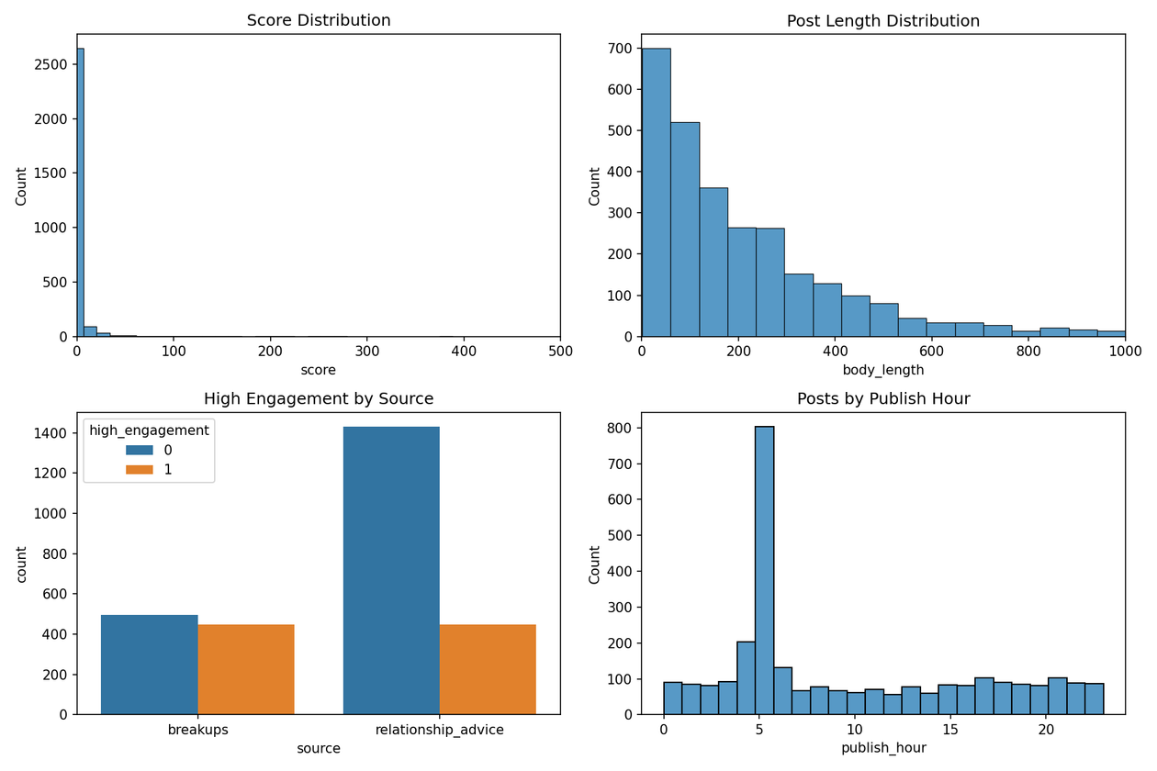
Initial visualizations
Key point : score distribution is heavily right-skewed. 90% of posts score below 10. Unusual spike at hour 5 flagged for investigation.

Slide 13
Initial findings
1.
2.
3.
4.
Median score is 1.0 — most posts are invisible
Post length averages 226 words, some exceed 2,000
Both subreddits split roughly 68% low / 32% high engagement
Unusual posting spike at 5am — possible timezone or scraping artifact

Slide 14
Checkpoint 4
Final Analysis and Machine Learning

Slide 15
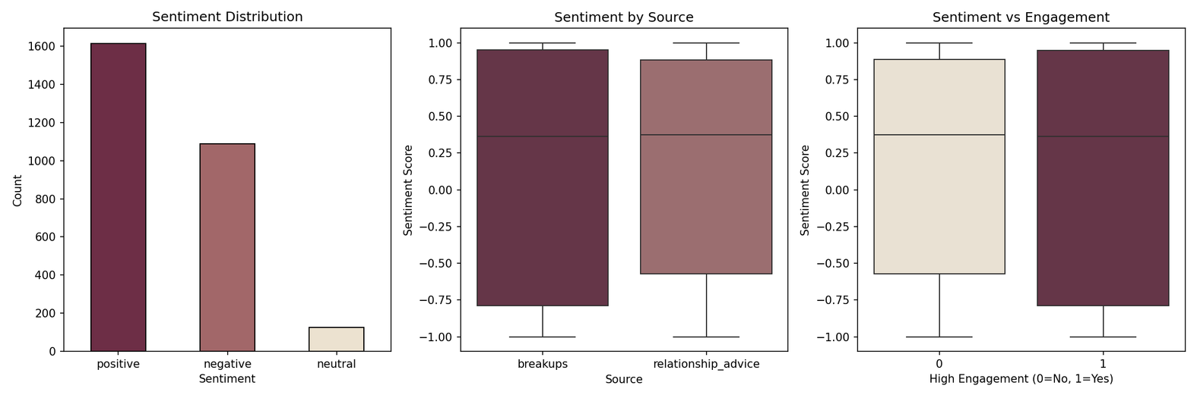
Sentiment analysis results
Stats:
1,613 positive (57%)
1,087 negative (38%)
125 neutral (5%)
Average body sentiment : +0.17
Key finding : even breakup posts trend positive; people frame experiences with hope, not just pain

Slide 16
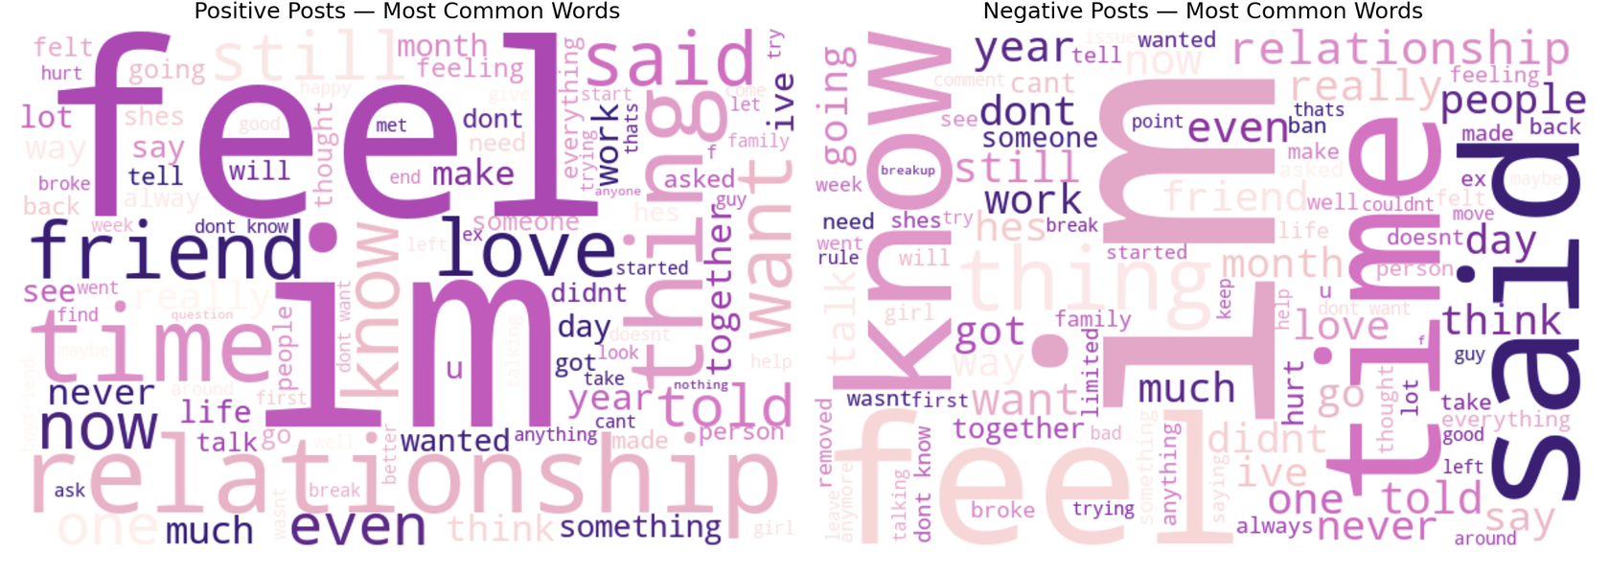
Word cloud
Key finding : positive and negative posts share almost identical vocabulary — feel, time, relationship, said. Framing shifts but language barely changes.

Slide 17
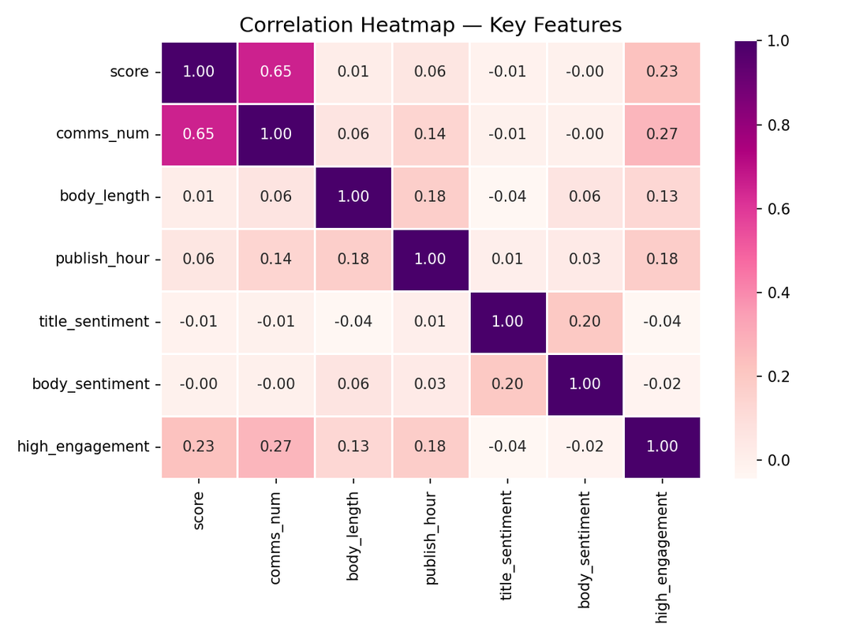
Correlation heatmap
Key numbers:
score vs comms_num: 0.65 (strong)
body_sentiment vs high_engagement: -0.02 (near zero)
comms_num vs high_engagement: 0.27 (strongest predictor)
Key finding : sentiment is essentially irrelevant to engagement

Slide 18
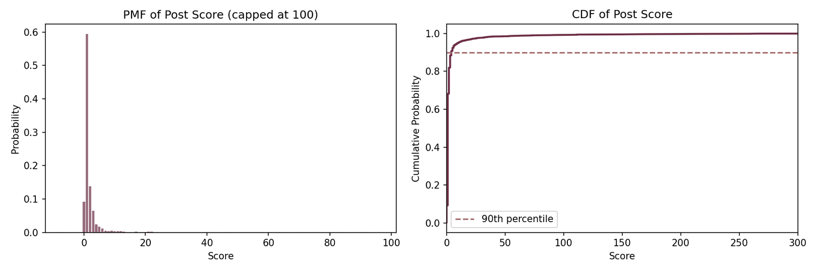
PMF & CDF
Key finding : 90% of all posts score below 10. Engagement is extremely concentrated — justifies binary label approach instead of predicting exact scores.

Slide 19
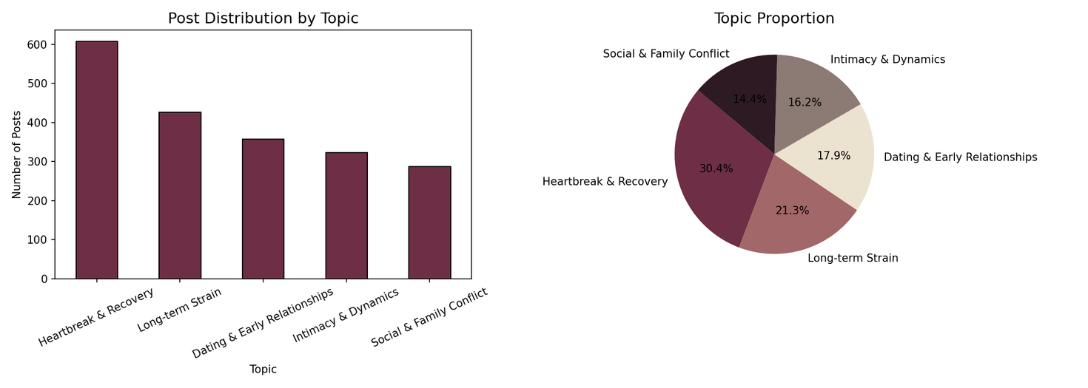
Topic clustering (LDA)
5 topics identified from 2,000 filtered posts:
Heartbreak & Recovery — 30.4%
Long-term Strain — 21.3%
Dating & Early Relationships — 17.9%
Intimacy & Dynamics — 16.2%
Social & Family Conflict — 14.4%

Slide 20
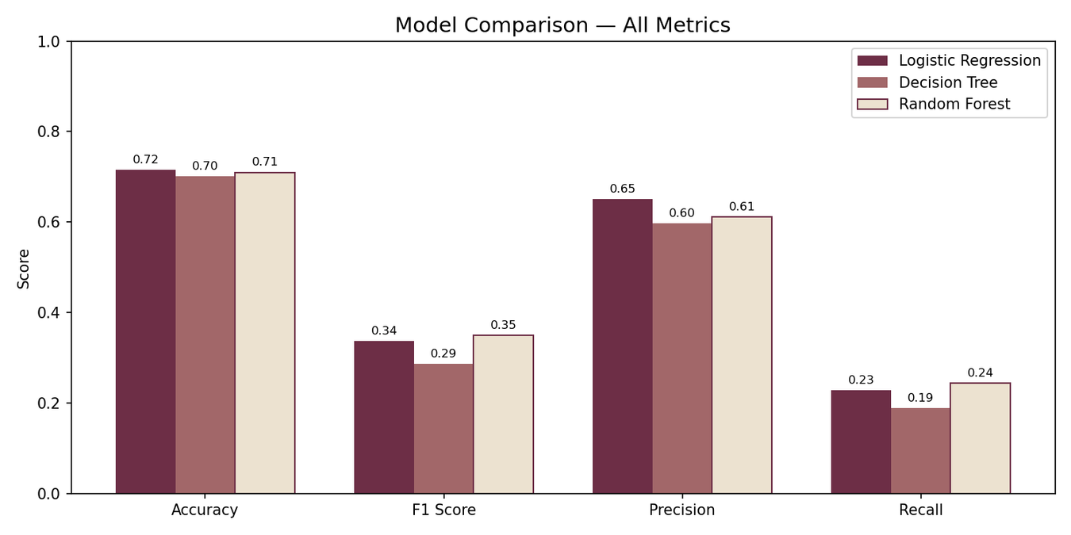
Baseline models
Model | Accuracy | F1 | Recall
LR | 0.72 | 0.34 | 0.23
DT | 0.70 | 0.29 | 0.19
RF | 0.71 | 0.35 | 0.24
80/20 train/test split, 5 features : body_length, publish_hour, title_sentiment, body_sentiment, comms_num
Problem identified : recall too low — models miss most high-engagement posts due to class imbalance

Slide 21
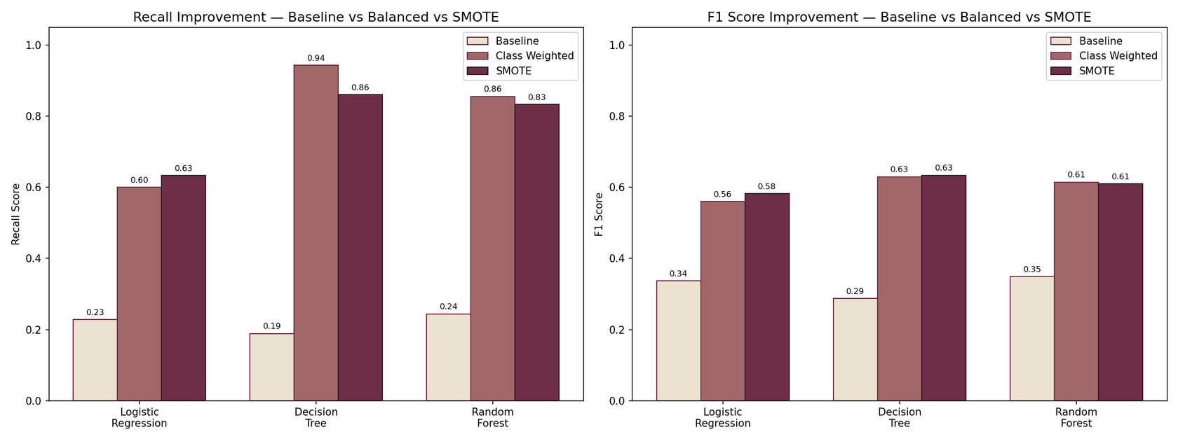
Model improvement
Two fixes applied:
class_weight='balanced'
SMOTE oversampling
Approach | Best recall
Baseline | 0.24
Class weighted | 0.94
SMOTE | 0.86
Key finding : recall improved from 24% to 94% — successfully identified and fixed the class imbalance problem

Slide 22
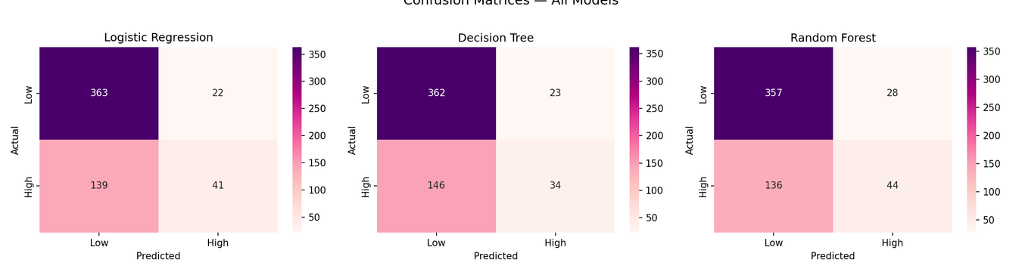
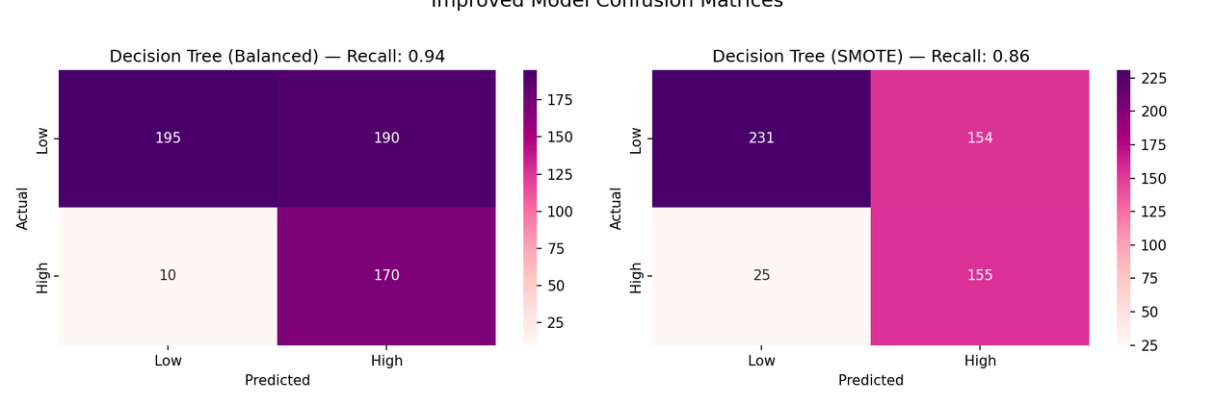
Confusion matrices
Before : models correctly caught only 34–44 high-engagement posts out of 180
After : significantly improved true positive rate

Slide 23


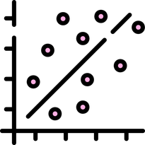


Final findings
Breakup posts trend positive — mean sentiment +0.17 despite painful topics
Vocabulary barely changes between positive and negative posts
Sentiment has near-zero correlation with engagement (-0.02)
Comment count is the strongest predictor (importance 0.50)
5 clear relationship themes identified through LDA

Slide 24
Recommendations
Post timing matters : publishing during peak hours increases visibility
Focus on narrative depth not emotional intensity : body_length predicts engagement better than sentiment
Community moderators can use this model to triage high-potential posts in real time
Platform designers should surface posts by structural signals, not just recency
Limitations
Dataset is a static snapshot : community behavior changes over time
External virality drivers not captured (cross-platform sharing, trending topics)
Binary engagement label oversimplifies a continuous phenomenon
Bot/moderation posts required filtering : 825 rows removed from LDA corpus

Slide 25
Future improvements
BERT or transformer-based embeddings for deeper semantic understanding
Multi-class engagement labels (Low / Medium / Viral)
Time-series modeling to capture engagement velocity
Cross-platform data integration

Slide 26
Conclusion
This project demonstrated that online relationship engagement is driven by structural and temporal factors — not emotional content. Starting from two raw Reddit datasets, we built a full analytics pipeline covering text cleaning, sentiment scoring, topic clustering, and classification modeling. By identifying and fixing class imbalance, we raised recall from 24% to 94%. The Sentiment Paradox — the finding that emotional tone barely predicts virality — is the central contribution of this work.

Slide 27
Thank You
Questions are welcome

